Slide 1
IP SAN
Module 2.4
Notes:
Module 2.4 – IP SAN

Slide 2
Module Objectives
Upon completion of this module, you will be able to:
Identify components of IP SAN
Describe benefits of IP SAN
Describe IP convergence in the SAN and its implications
Describe basic architecture of
  iSCSI
  FCIP
  FCoE
Notes:
The objectives for this module are shown here. Please take a moment to read them.

Slide 3
Lesson: IP SAN Protocols
Upon completion of this lesson, you will be able to:
Discuss market drivers for IP SAN technology
List IP SAN technologies
List components and connectivity options of iSCSI
Describe iSCSI architecture and topologies
Explain iSNS operation
Describe architecture of FCIP
Notes:
The objectives for this lesson are shown here. Please take a moment to read them.

Slide 4
Driver for IP SAN Internetworking
In FC SAN transfer of block level data takes place over Fibre Channel
Emerging technologies provide for the transfer of block-level data over an existing IP network infrastructure
IP is being positioned as a storage transport because:
  Easier management
  Existing network infrastructure can be leveraged
  Reduced cost compared to new SAN hardware and software
  Supports multi-vendor interoperability
  Many long-distance disaster recovery solutions already leverage IP-based networks
  Many robust and mature security options are available for IP networks
Notes:
- <number>
Traditional SAN environments allow block I/O over Fibre Channel, whereas NAS environments allow file I/O over IP-based networks. Organizations need the performance and scalability of SAN plus the ease of use and lower TCO of NAS solutions. The emergence of IP technology that supports block I/O over IP has positioned IP for storage solutions.
IP offers easier management and better interoperability. When block I/O is run over IP, the existing network infrastructure can be leveraged, which is more economical than investing in new SAN hardware and software. Many long-distance, disaster recovery (DR) solutions are already leveraging IP-based networks. In addition, many robust and mature security options are now available for IP networks. With the advent of block storage technology that leverages IP networks (the result is often referred to as IP SAN), organizations can extend the geographical reach of their storage infrastructure.
IP SAN technologies can be used in a variety of situations. Disaster recovery solutions can also be implemented using both of these technologies.

Slide 5
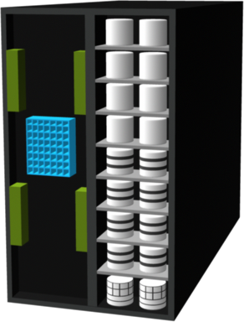
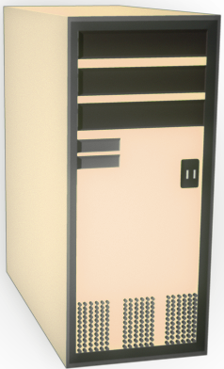
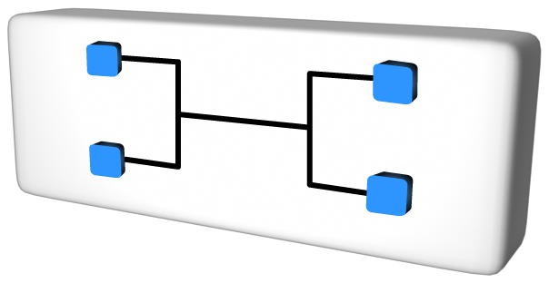
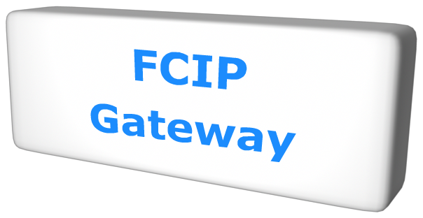
Block Storage Over IP – Protocol Options
iSCSI
  SCSI over IP
    IP encapsulation
      Ethernet NIC card
      iSCSI HBA
    Hardware-based gateway to Fibre Channel storage
  Used to connect servers
FCIP
  Fibre Channel-to-IP bridge / tunnel (point
  to point)
    Fibre Channel end points
  Used in DR implementations
Storage Array
iSCSI Gateway
IP
FC Port
Server
iSCSI HBA
iSCSI Port
(a) iSCSI Implementation
Storage Array
IP
Server
FC HBA
FC Port
Storage Array
(b) FCIP Implementation
Notes:
- <number>
Two primary protocols that leverage IP as the transport mechanism are iSCSI and Fibre Channel over IP (FCIP).
iSCSI is the host-based encapsulation of SCSI I/O over IP using an Ethernet NIC card or an iSCSI HBA in the host. As illustrated in Figure, IP traffic is routed over a network either to a gateway device that extracts the SCSI I/O from the IP packets or to an iSCSI storage array. The gateway can then send the SCSI I/O to an FC-based external storage array, whereas an iSCSI storage array can handle the extraction and I/O natively.
FCIP uses a pair of bridges (FCIP gateways) communicating over TCP/IP as the transport protocol. FCIP is used to extend FC networks over distances and/or an existing IP-based infrastructure, as illustrated in Figure. Today, iSCSI is widely adopted for connecting servers to storage because it is relatively inexpensive and easy to implement, especially in environments where an FC SAN does not exist. FCIP is extensively used in disaster-recovery implementations, where data is duplicated on disk or tape to an alternate site.

Slide 6
What is iSCSI ?
IP based protocol used to connect host and storage
Carries block-level data over IP-based network
Encapsulate SCSI commands and transport as TCP/IP packet
Notes:
iSCSI is an IP-based protocol that establishes and manages connections between storage, hosts, and bridging devices over IP. iSCSI carries block-level data over IP-based networks, including Ethernet networks and the Internet. iSCSI is built on the SCSI protocol by encapsulating SCSI commands and data in order to allow these encapsulated commands and data blocks to be transported using TCP/IP packets.

Slide 7
Components of iSCSI
iSCSI host initiators
  Host computer using a NIC or iSCSI HBA to connect to storage
  iSCSI initiator software may need to be installed
iSCSI targets
  Storage array with embedded iSCSI capable network port
  FC-iSCSI bridge
LAN for IP storage network
  Interconnected Ethernet switches and/or routers
Notes:
Host (initiators), targets, and an IP-based network are the principal iSCSI components. The simplest iSCSI implementation does not require any FC components. If an iSCSI-capable storage array is deployed, a host itself can act as an iSCSI initiator, and directly communicate with the storage over an IP network. However, in complex implementations that use an existing FC array for iSCSI connectivity, iSCSI gateways or routers are used to connect the existing FC SAN. These devices perform protocol translation from IP packets to FC packets and vice-versa, thereby bridging connectivity between the IP and FC environments.

Slide 8
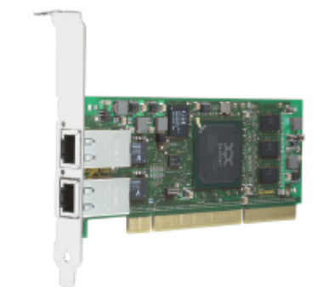
iSCSI - Host Connectivity Options
Three options for iSCSI configuration:
  Software Initiators
    Code that can be loaded onto a host to provide the translation between the storage I/O calls and the network interface
  TCP Offload Engine (TOE)
    Moves the TCP processing load off the host CPU onto the NIC card, to free up processing cycles for application execution
  iSCSI HBA
    A network interface adapter with an integrated SCSI ASIC (application-specific integrated circuit)
    Simplest option for boot from SAN
Notes:
iSCSI host connectivity requires a hardware component, such as a NIC with a software component (iSCSI initiator) or an iSCSI HBA. In order to use the iSCSI protocol, a software initiator or a translator must be installed to route the SCSI commands to the TCP/IP stack. A standard NIC, a TCP/IP offload engine (TOE) NIC card, and an iSCSI HBA are the three physical iSCSI connectivity options.
A standard NIC is the simplest and least expensive connectivity option. It is easy to implement because most servers come with at least one, and in many cases two, embedded NICs. It requires only a software initiator for iSCSI functionality. However, the NIC provides no external processing power, which places additional overhead on the host CPU because it is required to perform all the TCP/IP and iSCSI processing.
If a standard NIC is used in heavy I/O load situations, the host CPU may become a bottleneck. TOE NIC help alleviate this burden. A TOE NIC offloads the TCP management functions from the host and leaves iSCSI functionality to the host processor. The host passes the iSCSI information to the TOE card and the TOE card sends the information to the destination using TCP/IP. Although this solution improves performance, the iSCSI functionality is still handled by a software initiator, requiring host CPU cycles.
An iSCSI HBA is capable of providing performance benefits, as it offloads the entire iSCSI and TCP/IP protocol stack from the host processor. Use of an iSCSI HBA is also the simplest way for implementing a boot from SAN environment via iSCSI. If there is no iSCSI HBA, modifications have to be made to the basic operating system to boot a host from the storage devices because the NIC needs to obtain an IP address before the operating system loads. The functionality of an iSCSI HBA is very similar to the functionality of an FC HBA, but it is the most expensive option.

Slide 9
iSCSI Protocol Stack
Ethernet
IP
TCP
iSCSI
Notes:
The architecture of SCSI is based on the client/server model. Slide displays a model of the iSCSI protocol layers and depicts the encapsulation order of SCSI commands for their delivery through a physical carrier. SCSI is the command protocol that works at the application layer of the OSI model. The initiators and targets use SCSI commands and responses to talk to each other. The SCSI command descriptor blocks, data, and status messages are encapsulated into TCP/IP and transmitted across the network between initiators and targets.
iSCSI is the session- layer protocol that initiates a reliable session between a device that recognizes SCSI commands and TCP/IP. The iSCSI session-layer interface is responsible for handling login, authentication, target discovery, and session management. TCP is used with iSCSI at the transport layer to provide reliable service.
TCP is used to control message flow, windowing, error recovery, and retransmission. It relies upon the network layer of the OSI model to provide global addressing and connectivity. The layer-2 protocols at the data link layer of this model enable node-to-node communication for each hop through a separate physical network.

Slide 10
iSCSI Topologies
Native iSCSI Connectivity
Bridged iSCSI Connectivity
Combining FCP and Native iSCSI Connectivity
Notes:
The topologies used to implement iSCSI can be categorized into two classes: native and bridged. Native topologies do not have any FC components; they perform all communication over IP. The initiators may be either directly attached to targets or connected using standard IP routers and switches. Bridged topologies enable the co-existence of FC with IP by providing iSCSI-to-FC bridging functionality. For example, the initiators can exist in an IP environment while the storage remains in an FC SAN.

Slide 11
Native iSCSI Connectivity
Native iSCSI Port
IP
Servers
iSCSI HBA
Storage Array
No FC components
Each iSCSI port on the array is configured with an IP address and port number
  iSCSI Initiators Connect directly to the Array
Notes:
If an iSCSI-enabled array is deployed, FC components are not needed for iSCSI connectivity in the native topology. In the example shown in Figure, the array has one or more Ethernet NICs that are connected to a standard Ethernet switch and configured with an IP address and listening port. Once a client/ initiator is configured with the appropriate target information, it connects to the array and requests a list of available LUNs. A single array port can service multiple hosts or initiators as long as the array can handle the amount of storage traffic that the hosts generate.
Many arrays provide more than one interface so that they can be configured in a highly available design or have multiple targets configured on the initiator. Some NAS devices are also capable of functioning as iSCSI targets, enabling file-level and block-level access to centralized storage. This offers additional storage options for environments with integrated NAS devices or environments that don’t have an iSCSI/FC bridge.

Slide 12
Bridged iSCSI Connectivity
iSCSI Gateway
Storage Array
IP
Servers
iSCSI HBA
FC SAN
FC Port
FC HBA
Bridge device translates iSCSI/IP to FCP
  Standalone device
  Integrated into FC switch (multi-protocol router)
iSCSI initiator/host configured with bridge as target
Bridge generates virtual FC initiator
Notes:
A bridged iSCSI implementation includes FC components in its configuration. Figure illustrates an existing FC storage array used to service hosts connected through iSCSI. The array does not have any native iSCSI capabilities—that is, it does not have any Ethernet ports. Therefore, an external device, called a bridge, router, gateway, or a multi-protocol router, must be used to bridge the communication from the IP network to the FC SAN. These devices can be a stand-alone unit, or in many cases are integrated with an existing FC switch. In this configuration, the bridge device has Ethernet ports connected to the IP network, and FC ports connected to the storage. These ports are assigned IP addresses, similar to the ports on an iSCSI-enabled array. The iSCSI initiator/host is configured with the bridge’s IP address as its target destination. The bridge is also configured with an FC initiator or multiple initiators. These are called virtual initiators because there is no physical device, such as an HBA, to generate the initiator record.

Slide 13
Combining FCP and Native iSCSI Connectivity
Native iSCSI Port
IP
Servers
iSCSI HBA
FC SAN
Storage Array
FC Port
FC HBA
Array provides FC and iSCSI connectivity natively
No bridge devices needed
Notes:
A combination topology can also be implemented. In this case, a storage array capable of connecting the FC and iSCSI hosts without the need for external bridging devices is needed. These solutions reduce complexity, as they remove the need for configuring bridges. However, additional processing requirements are placed on the storage array because it has to accommodate the iSCSI traffic along with the standard FC traffic.

Slide 14
Internet Storage Name Server
For iSCSI communication, initiator must discover location of the target on a network
iSCSI discovery take place in two ways:
  SendTargets discovery
    initiator is manually configured with the target
  Internet Storage Name Service (iSNS)
    Initiators and targets automatically register themselves with iSNS server
    iSNS is a client/server model
An iSNS server can be hosted on a target, initiator, or stand-alone server with a specified IP address
Notes:
- <number>
For iSCSI communication an initiator must discover the location of the target on a network, and the names of the targets available to it before it can establish a session. This discovery can take place in two ways: SendTargets discovery and internet Storage Name Service (iSNS).
In SendTargets discovery, the initiator is manually configured with the target’s network portal, which it uses to establish a discovery session with the iSCSI service on the target. The initiator issues the SendTargets command, and the target responds with the names and addresses of the targets available to the host. iSNS enables the automatic discovery of iSCSI devices on an IP network. The initiators and targets can be configured to automatically register themselves with the iSNS server. Whenever an initiator wants to know the targets that it can access, it can query the iSNS server for a list of available targets.

Slide 15

iSNS Operation
A
iSNS
Target Z
B
Target Z - Device A – Initiator A
Target Z - Device B – Initiator B
Target Z - Device C – Initiator C
C
IP
Initiator A
Initiator C
Initiator B
Notes:
Due to the shared nature of the connectivity to the storage target, an administrator has two options for connectivity management:
Each initiator can be individually configured with a list of its authorized targets and each target can be configured with is list of initiators and access controls. An iSNS server can be configured with a list of initiators and targets, which can be done dynamically. Additional information can also be stored such as: Discovery Domains which organize the resources into manageable groups. Discovery domains are equivalent to zone sets in FC SAN Change State Services which provide notification of storage node change of state e.g. going off line, domain membership changes, IP link status, etc. Fibre Channel and iSCSI device mappings.

Slide 16
iSCSI Names
All initiators and targets require a unique iSCSI identifier
Two types of iSCSI names
  iqn.: iSCSI Qualified Name
    iqn.2008-02.com.example:optional_string
      Example: iqn.1992-05.com.emc:apm000339013630000-10
  eui.: Extended Unique Identifier
    eui.0300732A32598D26
Notes:
- <number>
A unique worldwide iSCSI identifier, known as an iSCSI name, is used to name the initiators and targets within an iSCSI network to facilitate communication. The unique identifier can be a combination of department, application, manufacturer name, serial number, asset number, or any tag that can be used to recognize and manage a storage resource. There are two types of iSCSI names:
iSCSI Qualified Name (IQN): An organization must own a registered domain name in order to generate iSCSI Qualified Names. This domain name does not have to be active or resolve to an address. It just needs to be reserved to prevent other organizations from using the same domain name to generate iSCSI names. A date is included in the name to avoid potential conflicts caused by transfer of domain names; the organization is required to have owned the domain name on that date. An example of an IQN is iqn.2008-02.com.example:optional_string The optional string provides a serial number, an asset number, or any of the storage device identifiers.
Extended Unique Identifier (EUI): An EUI is a globally unique identifier based on the IEEE EUI-64 naming standard. An EUI comprises the eui prefix followed by a 16-character hexadecimal name, such as eui.0300732A32598D26. The 16-character part of the name includes 24 bits for the company name assigned by IEEE and 40 bits for a unique ID, such as a serial number. This allows for a more streamlined, although less user-friendly, name string because the resulting iSCSI name is simply eui followed by the hexadecimal WWN. In either format, the allowed special characters are dots, dashes, and blank spaces. The iSCSI Qualified Name enables storage administrators to assign meaningful names to storage devices, and therefore manage those devices more easily.

Slide 17
iSCSI Error Handling and Security
The error detection and recovery in iSCSI can be classified into three levels:
  Level 0
    If SCSI session is damaged, all TCP connection needs to be closed
    Session restart via repeat login
  Level 1
    Each node selectively recover damaged packet
    Identification of error and data recovery at SCSI task level is performed
    Attempt to repeat the transfer of lost or damaged packet
  Level 2
    New TCP connections are opened to replace a failed connection
    New connection picks up where old one failed
Notes:
The iSCSI protocol addresses errors in IP data delivery. Command sequencing is used for flow control, the missing commands, and responses, and data blocks are detected using sequence numbers. Use of the optional digest improves communication integrity in addition to TCP checksum and Ethernet CRC.
The error detection and recovery in iSCSI can be classified into three levels: Level 0 = Session Recovery, Level 1 = Digest Failure Recovery and Level 2 = Connection Recovery. The error- recovery level is negotiated during login.
Level 0: If an iSCSI session is damaged, all TCP connections need to be closed and all tasks and unfulfilled SCSI commands should be completed. Then, the session should be restarted via the repeated login.
Level 1: Each node should be able to selectively recover a lost or damaged packet within a session for recovery of data transfer. At this level, identification of an error and data recovery at the SCSI task level is performed, and an attempt to repeat the transfer of a lost or damaged packet is made.
Level 2: New TCP connections are opened to replace a failed connection. The new connection picks up where the old one failed.
iSCSI may be exposed to the security vulnerabilities of an unprotected IP network. Some of the security methods that can be used are IPSec and authentication solutions such as Kerberos and CHAP (challenge-handshake authentication protocol).

Slide 18
What is FCIP (Fibre Channel over IP)
FCIP is an IP-based storage networking technology
Combines advantages of Fibre Channel and IP
Creates virtual FC links that connect devices in a different fabric
FCIP is a distance extension solution
  Used for data sharing over geographically dispersed SAN
FC SAN
IP
FC SAN
Host
Storage Array
Notes:
Organizations are now looking for new ways to transport data throughout the enterprise, locally over the SAN as well as over longer distances, to ensure that data reaches all the users who need it. One of the best ways to achieve this goal is to interconnect geographically dispersed SANs through reliable, high-speed links. This approach involves transporting FC block data over the existing IP infrastructure used throughout the enterprise. The FCIP standard has rapidly gained acceptance as a manageable, cost effective way to blend the best of two worlds: FC block-data storage and the proven, widely deployed IP infrastructure. FCIP is a tunneling protocol that enables distributed FC SAN islands to be transparently interconnected over existing IP- based local, metropolitan, and wide-area networks. As a result, organizations now have a better way to protect, store, and move their data while leveraging investments in existing technology.

Slide 19
FCIP Frame
Encapsulates FC frames in IP packets
  FCIP Router is used for encapsulation
  FC Router at other end removes IP wrapper and sends FC data to other fabric
Includes security, data integrity, congestion and performance specifications
IP
TCP
FCIP
Header
Header
Header
Notes:
- <number>
FCIP uses TCP/IP as its underlying protocol. In FCIP, the FC frames are encapsulated onto the IP payload, as shown in Figure. FCIP does not manipulate FC frames (translating FC IDs for transmission). When SAN islands are connected using FCIP, each interconnection is called an FCIP link. A successful FCIP link between two SAN islands results in a fully merged FC fabric.
An FCIP gateway router is connected to each fabric via a standard FC connection. The fabric treats these routers like layer 2 fabric switches. The other port on the router is connected to an IP network and an IP address is assigned to that port. Once IP connectivity is established, the two independent fabrics are merged into a single fabric.

Slide 20
Lesson Summary
Key points covered in this lesson:
iSCSI components
iSCSI frame structure and topologies
iSNS operation
iSCSI error handling and security
Architecture of FCIP
Notes:
This concludes the lesson. Key points covered in this lesson are shown here. Please take a moment to review them.

Slide 21
Lesson: Fibre Channel over Ethernet (FCoE)
Upon completion of this lesson, you will be able to:
Discuss the FCoE and its benefits
Describe how FCoE works
Describe FCoE physical and logical elements
Compare different protocol stack
Notes:
These are the objectives for this course. Please take a moment to read them.

Slide 22
Fibre Channel over Ethernet (FCoE)
A new protocol that maps Fibre Channel protocol natively over Ethernet
Based on two new standards that are currently in active development:
  FCoE standard, being developed by T11 Fibre Channel Interfaces Technical Committee
  Enhanced Ethernet standard, being developed by the Ethernet IEEE Data Center Bridging Task Group
  Both standards are expected to be ratified in 2009
Enables the consolidation of SAN traffic and Ethernet traffic onto a common 10 Gigabit network infrastructure
Notes:
Fibre Channel over Ethernet, FCoE is a proposed standard for using the Fibre Channel protocol over Ethernet networks. FCoE enables SAN traffic to be natively transported over Ethernet networks, while protecting and extending the investment that enterprises have made in storage networks. FCoE basically would enable organizations to continue to run Fibre Channel over the same wires as their data networks.
Unlike other storage networking protocols that use Ethernet, the emerging FCoE standard will utilize a new version of the Ethernet standard that makes it more reliable. The new “Enhanced” Ethernet known as Converged Enhanced Ethernet (or CEE), will protect Fibre Channel data traveling over Ethernet by eliminating frame drops, thus making it a lossless fabric. DCE (Data Center Ethernet) is the Cisco marketing term for CEE.
FCoE combined with 10 Gigabit Ethernet (10 Gbps) fabrics will grant organizations the ability to consolidate their I/O, cables and adapters while at the same time increase the utilization of their servers. It combines LAN and SAN Traffic over a single 10Gb Ethernet connection.

Slide 23
FCoE: Benefits
Lower capital expenditure
  Dramatic reduction in the number of adapters, switch ports and cables required
Reduced power and cooling requirement
Enabler for consolidated network infrastructure
  Potentially lower administration cost, with convergence of LAN and SAN
  Effective sharing of high-bandwidth links
Lower Total Cost of Ownership (TCO)
Notes:
The benefits of FCoE include lower capital and operating costs, lower cooling requirements and power savings. This results in lower total cost of ownership.
FCoE enables input/output consolidation by allowing LAN and SAN traffic to converge on a single cable or link. It reduces the number of server cables, adapters and switch ports in the data center and greatly simplifies the physical infrastructure. It also reduces the administrative overhead and complexity associated with managing the data center.

Slide 24
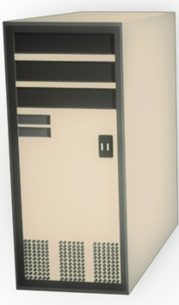
I/O Consolidation with FCoE
CNA
LAN Ethernet
FC HBA
SAN (FCoE)
SAN (FC)
LAN (Ethernet)
NIC
CNA
Typical Server Connectivity in data center environments
Server with CNA
supporting both SAN and LAN
Notes:
Today, servers often use four, six or even eight network adapters. These adapters can be two Fibre Channel host bus adapters, plus a pair of Network Interface Cards.
FCoE allows the use of multi-function network/storage adapters called Converged Network Adapters (CNA) consolidating both network and storage traffic. With CNAs, there is no need to deploy separate hardware and cables based upon different traffic types, thereby reducing the number of server slots and switch ports, as well as power required for I/O and necessary cooling.

Slide 25
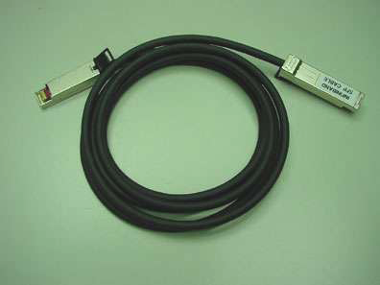
FCoE - Physical Elements
Host Interface: CNA (Converged Network Adapter)
  PCIe card on host consolidates NICs and HBAs
  Provides a 10 Gigabit Ethernet link that carries consolidated traffic
10 Gbps connectivity options: Host to FCoE switch
  Option1: Copper-based Twinax
    Cost effective option
  Option2: Standard optical SFP+
FC
10Gbps
Ethernet
/FCoE
Menlo
ASIC
10 GE
PCIe Bus
CNA
Twinax Cable
Notes:
The CNA (Converged Network Adaptor) consolidates the data networking of a NIC card with the storage networking of a Fibre Channel HBA onto a single adapter. It eliminates the need of separate interface cards for FC, IP network and it consolidates the I/O onto a single 10 Gigbit Ethernet link .The internals of the first generation CNAs include separate 10 Gigabit Ethernet, Fibre Channel and Menlo ASICs. The Menlo ASIC is used to encapsulate Fibre Channel frames into Ethernet frames.
There are two connectivity options: copper based Twinax and standard optical. Copper-based Twinax cables are the cost effective option. A Twinax cable is composed of two pairs of copper cables that are covered with a shielded casing. Each end of the Twinax cable is terminated with an SFP and a GBIC.

Slide 26
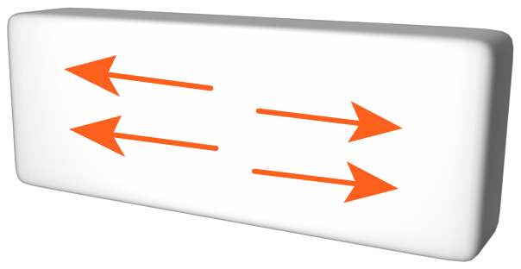
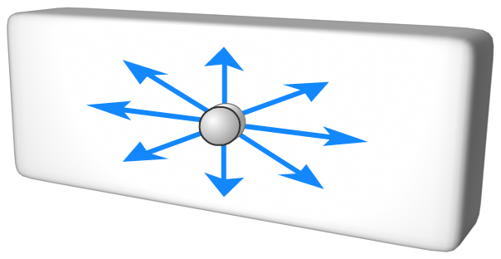
Infrastructure - Before FCoE
………
Storage Arrays
LAN
IP Edge Switches
FC
Switches
…………
Hosts
Notes:
- <number>
Shown is the topology of the current infrastructure where LAN and SAN are two different networks. Storage resources are accessible using HBAs and network resources that are accessible using NICs by hosts.

Slide 27
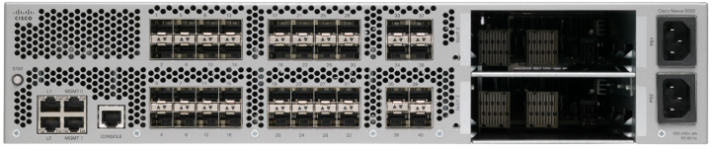
Infrastructure – With FCoE
…………
LAN
Storage Arrays
FCoE Switch
FCoE links
…………
Hosts
Notes:
- <number>
Shown is the I/O consolidation with FCoE using FCoE switches and CNAs. The FCoE switch passes Fibre Channel traffic to the SAN, and the Ethernet traffic to an attached Ethernet network.
With FCoE, the cable requirements from host to FCoE switches can be substantially reduced, which in turn reduces the cooling costs, management requirements, and the overall operational cost.

Slide 28
FCoE – Frame Structure
Normal Ethernet Frame: Ether Type = FCoE
Control Information: Version and Ordered Sets (SOF and EOF)
Same as a Physical Fibre Channel Frame
Ethernet
Header
FCoE
Header
FC
Header
EOF
FCS
Fibre Channel Payload
CRC
24 Bytes
4 Bytes
Up to 2112 Bytes
16 Bytes
12 Bytes (MAC Addresses) + 4 Bytes
(802.10 TAG)
1 Byte(EOF) + 3 Bytes (Padding)
Notes:
Frame size is also an important factor in FCoE. A typical Fibre Channel data frame has a 2112 byte payload, a header and an FCS. A classical Ethernet frame is typically 1.5 KB or less. FCoE requires jumbo frames (2180-byte) support to prevent a Fibre Channel frame from being split into two Ethernet frames.
FCoE can not run on the existing customers production Ethernet network, like iSCSI. It requires specific Ethernet extensions and Jumbo Frame support.

Slide 29

Lossless Ethernet
No frame drop due to congestion or buffer overflow
  Fibre Channel manages congestion through link level, credit based flow control
  Ethernet uses drop flow control method which is not lossless
PAUSE capability of Ethernet is used to achieve the lossless fabric
  Busy receive port can send the control frame to the transmit port for pause in transmission
Ethernet traffic
Receiver – Port B
Sender – Port A
FRAMES
PAUSE
QUEUE
FULL
Notes:
To support Fibre Channel frames over Ethernet, no frames can be dropped throughout the entire transmission. Congestion needs to be managed in a lossless network. Fibre channel manages congestion through a link level, credit flow control based mechanism. Typical Ethernet, coupled with TCP/IP, uses a packet drop flow control mechanism to manage the traffic. Packet drop flow control is not lossless making it unacceptable for use with storage traffic.
Ethernet has a PAUSE capability so that a busy receive port can send a control frame to the transmit port requesting a pause in transmission. Use of this optional IEEE 802.3x Ethernet feature enables Fibre Channel traffic to pass on an Ethernet network in a lossless fabric.

Slide 30
Network Stack Comparison
SCSI
SCSI
SCSI
SCSI
SCSI
iSCSI
FCP
FCP
FCP
FC
FC
FC
FCIP
Less Overhead
than FCIP, iSCSI
TCP
TCP
IP
IP
FCoE
Ethernet
Ethernet
Ethernet
PHYSICAL WIRE
SCSI
iSCSI
FCIP
FCoE
FC
Notes:
- <number>
Several protocols exist to run storage on Ethernet in the data center, most notably iSCSI and FCIP. They both require the use of TCP/IP, adding unnecessary overhead in a data center environment. FCoE bypasses TCP/IP.
FCoE would provide an efficient storage protocol for use on a consolidated Ethernet Fabric within the data center as shown.

Slide 31
Lesson Summary
Key points covered in this lesson:
Basics and benefits of FCoE
Storage infrastructure with FCoE
FCoE Architecture and stack comparison
Notes:
These are the key points covered in this course. Please take a moment to review them.
This concludes the training. In order to receive credit for this course, please proceed to the Course Completion slide to update your transcript and access the assessment.

Slide 32
Module Summary
Key topics covered in this module:
Benefits of IP SAN
IP convergence in the SAN and its implications
Architecture and implementation of iSCSI
Architecture and implementation of FCIP
Convergence of new protocol FCoE
Notes:
This concludes the module. Key points covered in this module are shown here. Please take a moment to review them.

Slide 33
Check Your Knowledge
✓
What is the difference between a native and bridged iSCSI implementation?
Explain the benefits and drawbacks of using: NIC, TOE and iSCSI HBA
Name two iSCSI discovery mechanisms
What are two types of iSCSI names, and which one is similar to a Fibre Channel name?
What are the physical elements of FCoE?
Explain the benefit of using CNA card

